Slide 1
China: History and Culture

Slide 2
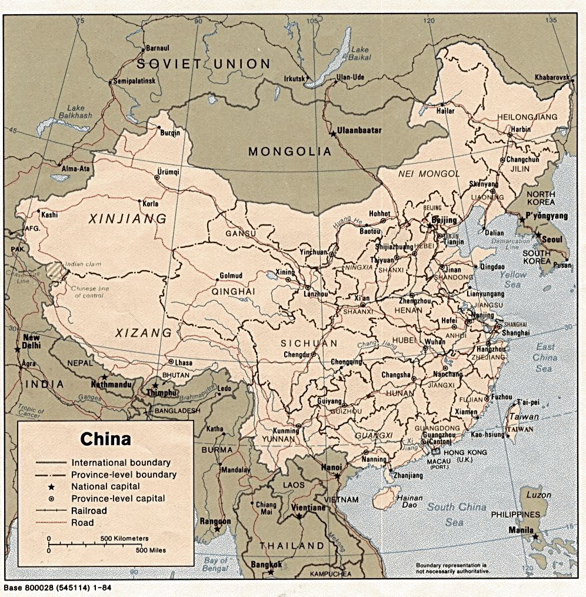

Slide 3
China, 3,600,000 square miles in extent, is about the same size as the United States and second only to Soviet Russia in area.
The Land
  Among the 5 principal rivers, there are the Yellow River, Yangzi River, and the West River which are among the famous ones
  The Yellow River (Huang He) is 2,700 miles long, rising in the Tibetan plateau.

Slide 4
  The Yellow River has been called “China Sorrow” because it is liable to extensive flooding.
  The Yellow River is not navigable for most of its length save by small native boats
  The Yangzi River, Yangzi is China’s greatest river, 3,200 miles long and sixth in length in the world is navigable for a thousand miles, by large steamships all year round

Slide 5
  The north China has dry, cold, dessert winds in winter; the south has the most climate of the southeastern summer monsoon

Slide 6
The first dynasty that is meaningfully dynasty was Shang
  Oracle Bones
  Dragon Bones
  Beginning to Chinese Civilization – Characters and Deciphered
  Beginning of China’s Bronze age

Slide 7
Do you think the Dragon exist?

Slide 8
During the Western Zhou Dynasty, the idea of the “Mandate of Heaven", by which the ruler had to deserve his supremacy by governing well, is first encountered

Slide 9
In Zhou, two musical creations:
  Birth of Ritual Music
  Bells formed an important part of Zhou
Notes:
The last Shan ruler, a despot according to standard Chinese accounts, was overthrown by a chieftain of a frontier tribe called Zhou ( ), which had settled in the Weir ( ) Valley in modern Shania ( ) Province. The Zhou dynasty had its capital at Hao ( ), near the city of Xi'an ( ), or Chang'an ( ), as it was known in its heyday in the imperial period. Sharing the language and culture of the Shang, the early Zhou rulers, through conquest and colonization, gradually sinicized, that is, extended Shang culture through much of China Proper north of the Chang Jiang ( or Yangtze River). The Zhou dynasty lasted longer than any other, from 1027 to 221 B.C. It was philosophers of this period who first enunciated the doctrine of the "mandate of heaven" (tianming or ), the notion that the ruler (the "son of heaven" or ) governed by divine right but that his dethronement would prove that he had lost the mandate. The doctrine explained and justified the demise of the two earlier dynasties and at the same time supported the legitimacy of present and future rulers.
The term feudal has often been applied to the Zhou period because the Zhou's early decentralized rule invites comparison with medieval rule in Europe. At most, however, the early Zhou system was proto-feudal ( ), being a more sophisticated version of earlier tribal organization, in which effective control depended more on familial ties than on feudal legal bonds. Whatever feudal elements there may have been decreased as time went on. The Zhou amalgam of city-states became progressively centralized and established increasingly impersonal political and economic institutions. These developments, which probably occurred in the latter Zhou period, were manifested in greater central control over local governments and a more routinized agricultural taxation.
In 771 B.C. the Zhou court was sacked, and its king was killed by invading barbarians who were allied with rebel lords. The capital was moved eastward to Luoyang ( ) in present-day Henan ( ) Province. Because of this shift, historians divide the Zhou era into Western Zhou (1027-771 B.C.) and Eastern Zhou (770-221 B.C.). With the royal line broken, the power of the Zhou court gradually diminished; the fragmentation of the kingdom accelerated. Eastern Zhou divides into two subperiods. The first, from 770 to 476 B.C., is called the Spring and Autumn Period ( ), after a famous historical chronicle of the time; the second is known as the Warring States Period (475-221 B.C. ).

Slide 10
Dates Dynasty
221-207 B.C. Qin

Slide 11
First Emperor appears - he took the title Xi Huang Di ( First Emperor )
Consolidated power
Great Wall was built
Long plucked zithers, and flutes are among the instruments that was believed to have been invented during this period
Notes:
To silence criticism of imperial rule, the kings banished or put to death many dissenting Confucian scholars and confiscated and burned their books (
Revolts broke out as soon as the first Qin emperor died in 210 B.C. His dynasty was extinguished less than twenty years after its triumph. The imperial system initiated during the Qin dynasty, however, set a pattern that was developed over the next two millennia.

Slide 12
Confucian ideals of government, out of favor during the Qin period, were adopted as the creed of the Han empire, and Confucian scholars gained prominent status as the core of the civil service

Slide 13
Two of the great Chinese inventions, paper and porcelain, date from Han times.

Slide 14
The Han dynasty, after which the members of the ethnic majority in China, the "people of Han," are named.

Slide 16
  An account of the music activities of the Qin-Han period can be understood as a growth in 4 major areas:
  imperial court music - “Yuefu” official Music Bureau was established
  Urban music as a dominant musical language – general life improves, arts flourished
  band music – percussion and wind instrument for War like activities
  musical instruments and tonal system – new instruments were developed

Slide 17
In the Han Dynasty, the empire expanded westward as far as the rim of the Tarim Basin making possible relatively secure caravan traffic across Central Asia to Antioch, Baghdad, and Alexandria. The paths of caravan traffic are often called the "silk route" because the route was used to export Chinese silk to the Roman Empire

Slide 18
About the same time frame of the Christian era – Old Testament records
Technology and invention did not lag behind:
  Wheelbarrow improved to carry over 300 pounds.
  Two Han mathematical books have survived

Slide 19
Both the Sui and Tang Dynasty are considered as the Flowering of Chinese Civilization
Under Sui, the Great Wall was extended and Grand Canal were dug
Expanded their power also toward the south but met difficulties in Korea

Slide 20
Dates Dynasty
A.D. 581-617 Sui
A.D. 618-907 Tang

Slide 21
In the Tang Dynasty, Buddhism, originating in India around the time of Confucius, flourished during the Tang period, becoming thoroughly sinicized and a permanent part of Chinese traditional culture
Block printing was invented, making the written word available to vastly greater audiences.

Slide 22
The Tang period was the golden age of literature and art.
  Musical instructions was popular
  “Yanyue” – “Banquet Music” was made popular once again since the Zhou dynasty
  Japanese Gagaku musical style was said to have resemblance in the yanyue tradition
  “Daqu” or “Grand song and Dance” was the most significant musical form for the Tang Dynasty

Slide 23
In 1215, the Yuan Dynasty, the Mongols destroyed Beijing and in 1233 overthrew the Jin.
Paper and printing came to a general use in Song
Compass was invented
Gunpowder was discovered but the main use was for fireworks
Landscape painting is said to be at the highest point of Chinese history

Slide 24
Genghis Khan improved the whole system of communication, control, and strict discipline in battle tactics and brought these to a higher level of efficiency.
  A Fearless leader

Slide 25
Kublai Khan
  In 1260 took the tile as emperor of China
  Marco Polo visited During this period
  He made sure that Mongols in China were dominant both in military and administrative spheres
    Chinese have the lower posts
    Intermarriages between groups were forbidden
    Chinese were denied all possession of arms

Slide 26
Ming 1368-1644
Zhu Yuan Zhang –from beggar to emperor
former Buddhist monk turned rebel army leader
Nothing foreign was needed or welcome
Heavy Taxes to the rich made the gap between rich and poor diminished
Re-establishment of the Civil service examinations

Slide 27
QING DYNASTY 1644-1912
Decline of the Empire
Although the Manchus were not Han Chinese and were strongly resisted, especially in the south
The Manchus continued the Confucian civil service system. Although Chinese were barred from the highest offices
Han Chinese were prohibited from migrating into the Manchu homeland, and Manchus were forbidden to engage in trade or manual labor

Slide 28
Strong impact from the west:
  Opium War with Britian
  Taiping Rebellion
  Japanese Pre-occupation struggles
  Qixi died in 1908, She name Pu Yi as the next emperor when her son Quang Xu had passed away
  https://www.youtube.com/watch?v=ArErB_YSDYs

Slide 29

Dates Dynasty
A.D. 1911-1949 Republic of China
(in mainland China)
A.D. 1949- Republic of China
(in Taiwan)
A.D. 1949- People's Republic of China

Slide 30
Republic Era
Sun Yat Sian, father of the republic. Not a political boss or a warlord but a “pure” revolutionist
  At the age of 12, came to Hawaii attended a church of England school
  Received medical training but fail to get a medical license
  Western influence covers the entire musical scene

